Slide 1


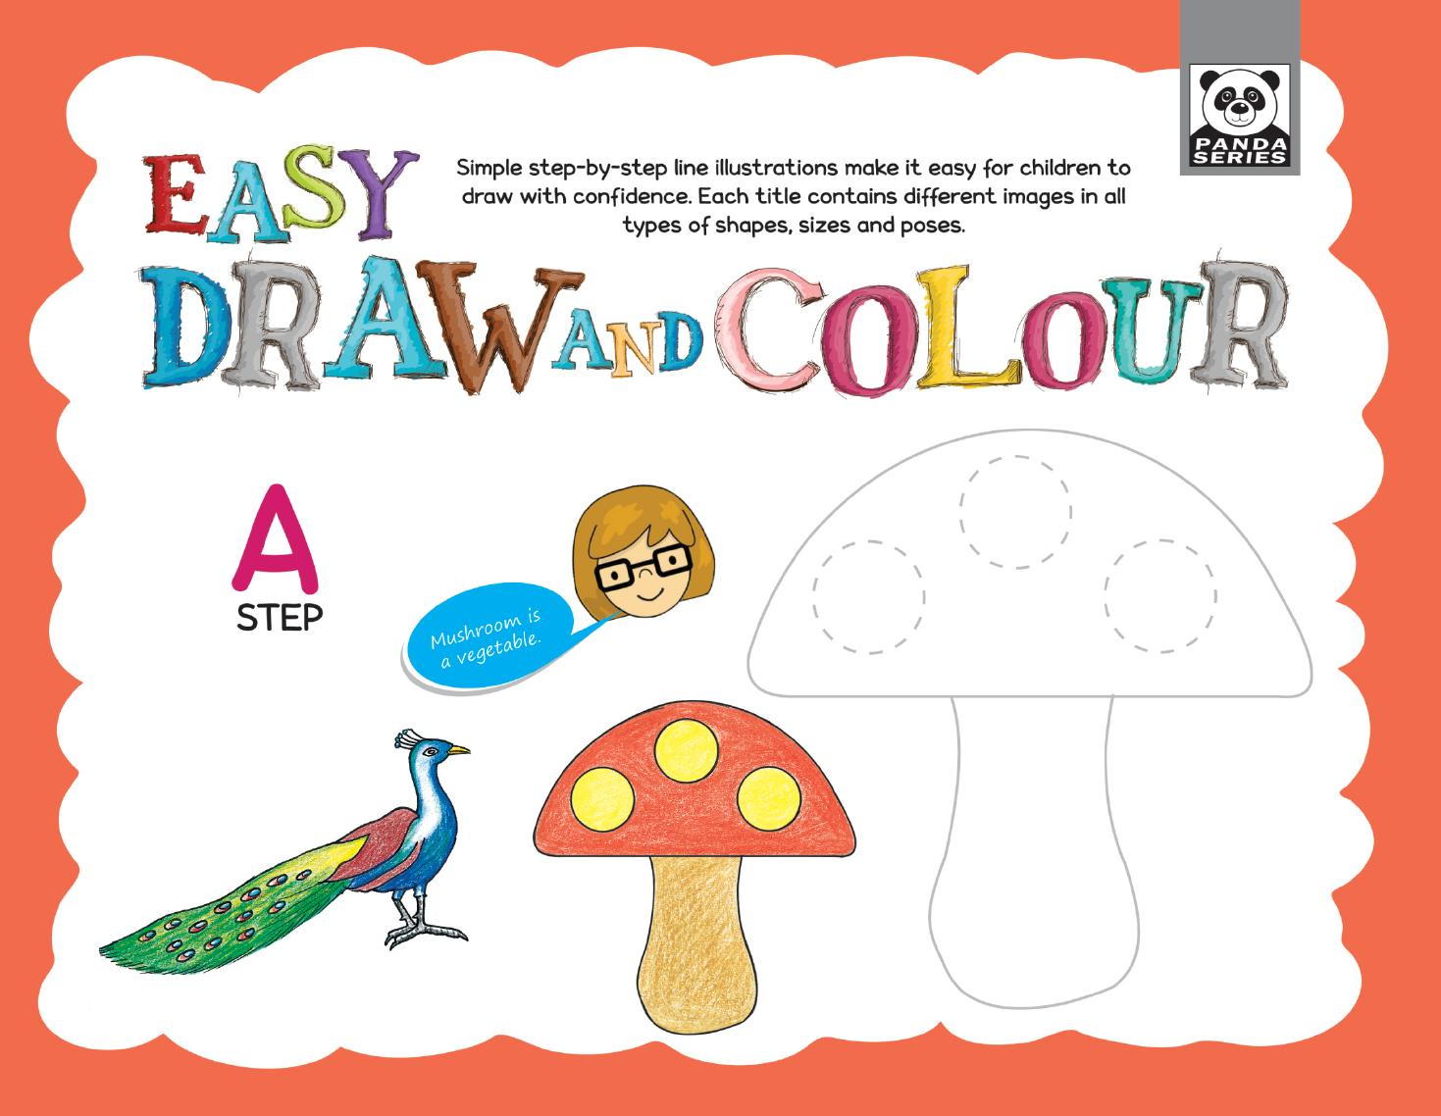
Easy Draw and Colour — Step A
Playgroup • Age 3+
An activity-based early-years book from the Panda Series.
A Project of Azhar Publishers & Book Factory

Slide 2
i
What's Inside
Easy Draw and Colour — Step A Playgroup • Age 3+
1
Straight, wavy lines and basic shapes
2
Step-by-step draw and colour
3
Tracing, dot-to-dot and colour-by-dots
4
Match, colour and thumb-impression fun
5
Paste, collage and grid activities
6
Animals, fruits, vehicles and more

Slide 3
★
Purpose & Classroom Support
Simple step-by-step line illustrations help children draw with confidence and develop pencil control and creativity.
“
Every book comes with
1
2
3
Teacher's Lesson Plan
Practice Papers
Digital Interactive Version
A 40-week lesson plan that guides teachers, day by day.
Monthly tests and term exam papers for children to attempt.
An interactive flipbook and digital exercises for engaging, screen-based practice.
A Project of Azhar Publishers & Book Factory

